Slide 1


CHAPLAINCY 101
OFFICE OF TRAINING & DEVELOPMENT

Slide 2
PEARL CHAPLAINCY MEMBERSHIP

Slide 3
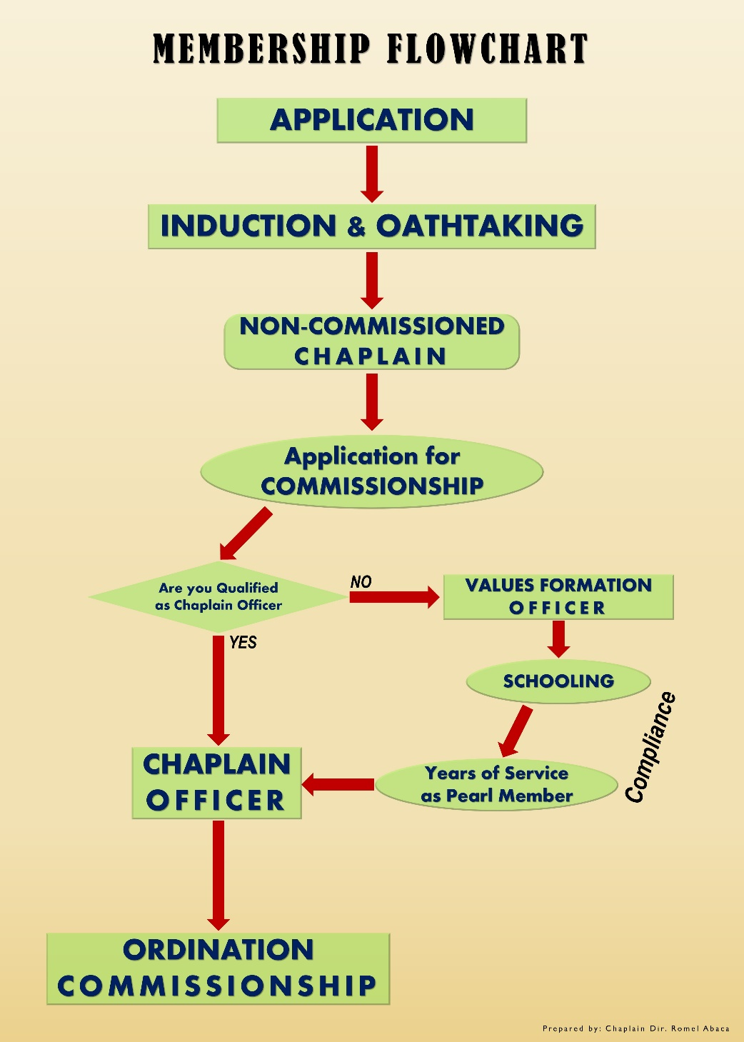
MEMBERSHIP CATEGORIES:
1. VALUES FORMATION OFFICER.
2. CHAPLAIN OFFICER.

Slide 4
MEMBERSHIP CATEGORIES:
1. VALUES FORMATION OFFICER.
Qualifications:
A God-fearing individual with good moral character.
18years old and above.
Atleast 2years in any ministerial work.

Slide 5
MEMBERSHIP CATEGORIES:
1. VALUES FORMATION OFFICER.
Qualifications:
With Pastor’s recommendation.
High School graduate.
Willing and able to undergo trainings and seminars.

Slide 6
MEMBERSHIP CATEGORIES:
2. CHAPLAIN OFFICER.
Qualifications:
A God-fearing individual with good moral character.
25years old and above.
Atleast 5years in any Ministerial work,
(or 5years active service in Pearl Chaplaincy)

Slide 7
MEMBERSHIP CATEGORIES:
2. CHAPLAIN OFFICER.
Qualifications:
With Ministerial Certificate or Pastoral Ordination. (or equivalent)
A graduate of Bachelors Degree in Theology or any.
Willing and able to undergo trainings and seminars.

Slide 8
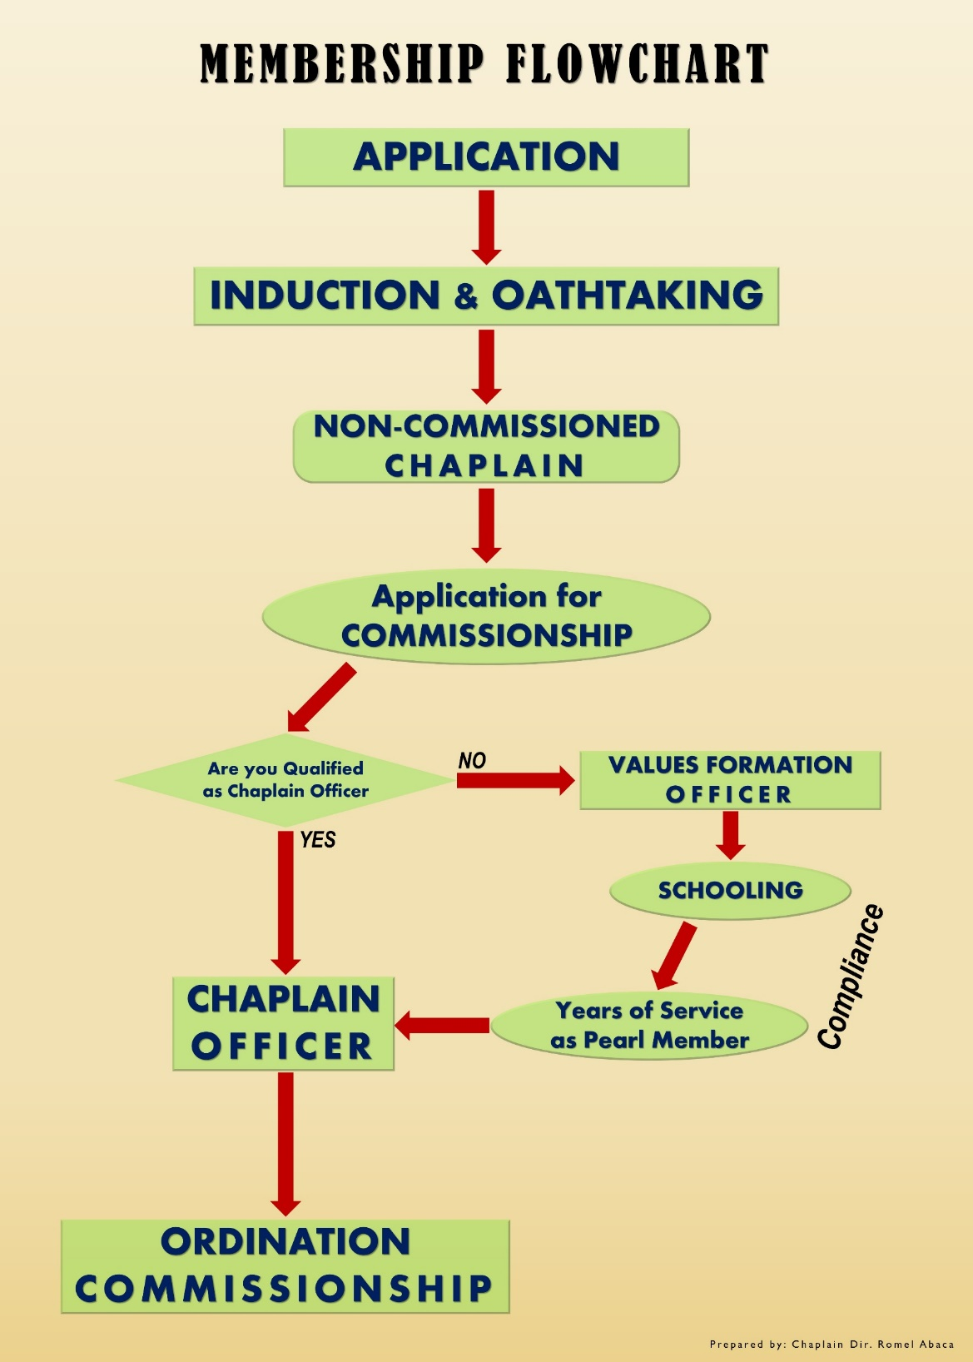

Slide 9
PEARL CHAPLAINCY MEMBERSHIP STATUS
1. Active Member.
A member shall be classified as active if he complies the requirements indicated below:
a. Participate in at least fifty percent (at least 50%) of the authorized PEARL Chaplaincy annual activities and programs.

Slide 10
PEARL CHAPLAINCY MEMBERSHIP STATUS
1. Active Member.
A member shall be classified as active if he complies the requirements indicated below:
b. Attend at least fifty percent (at least 50%) of the PEARL Chaplaincy meetings and conferences.

Slide 11
PEARL CHAPLAINCY MEMBERSHIP STATUS
1. Active Member.
A member shall be classified as active if he complies the requirements indicated below:
c. Regularly submitting his accomplishment report as chaplain in his respective Area of Responsibility(AOR).

Slide 12
PEARL CHAPLAINCY MEMBERSHIP STATUS
1. Active Member.
A member shall be classified as active if he complies the requirements indicated below:
d. Renewing his membership.
Active Members are physically-fit personnel that are always on constant alert and training; and ready to mobilize once a mobilization order has been given.

Slide 13
PEARL CHAPLAINCY MEMBERSHIP STATUS
2. Inactive member.
A member will be declared to be in inactive status due to the following reasons that are duly validated:
a. Serious health problems
b. Failure to submit his accomplishment report as chaplain in his respective AOR for two consecutive years.

Slide 14
PEARL CHAPLAINCY MEMBERSHIP STATUS
2. Inactive member.
A member will be declared to be in inactive status due to the following reasons that are duly validated:
c. Failure to attend the required regular meetings and activities for two consecutive years.
d. Failure to renew his membership for two consecutive years.

Slide 15
PEARL CHAPLAINCY MEMBERSHIP STATUS
2. Inactive member.
Inactive members may be restored to active status under the following conditions and as recommended by his immediate superior and approved by our Chief Chaplain:
1) Has manifested willingness by attending regular meetings again; and

Slide 16
PEARL CHAPLAINCY MEMBERSHIP STATUS
2. Inactive member.
Inactive members may be restored to active status under the following conditions and as recommended by his immediate superior and approved by our Chief Chaplain:
2) Has paid the renewal of his membership.

Slide 17




THANKS FOR COMING

